Slide 1
DastiCrafts
Handicrafts you’ve been looking for, at your door step

Slide 2
Team Members
Ahmed Yousaf (BSCS-13063)
Faisal Noor (BSCS-13021)
Saqib Javed (BSCS-13064)
Umer Ahmed (BSCS-13075)
Presented to:
Dr. Zubair Malik

Slide 3
Division of Project
Need finding
POVs + HMWs + Solutions
Concept Video
Low-fi Prototype
Medium-fi Prototype
Heuristic Evaluation
High-fi Prototype
Website

Slide 4
Need Finding Methodology
Brainstorming
Conducted interviews of the prime stakeholders:
Artisans
Customers

Slide 5
Customers
We usually buy handicrafts on festivals or rarely find any shop from where we can buy hand made products.
The major problem we face while buying handicrafts is the poor quality of the products.
If these products are available online we will definitely buy them because in this way we will have access to more options and variety.

Slide 6
Conclusion
There is a gap in the online market of such products.
People are willing to buy such products if easily available.
The artisans are willing to collaborate with us by all means.
If we build such an application, it is going to help the consumer and artisans as well.
It will help increase consumer market of handicrafts.

Slide 7
Why DastiCraft?
DastiCraft is a platform where people will be able to buy different kind of handicrafts of their own choice (customized products).

Slide 8
Division of Tasks
Simple Task:
Handicrafts can be bought easily at DastiCraft.
Moderate Task:
People can buy different kind of handicrafts at DastiCraft.
Complex Task:
People can buy handicrafts of their own choice (customized products) at DastiCraft.

Slide 9
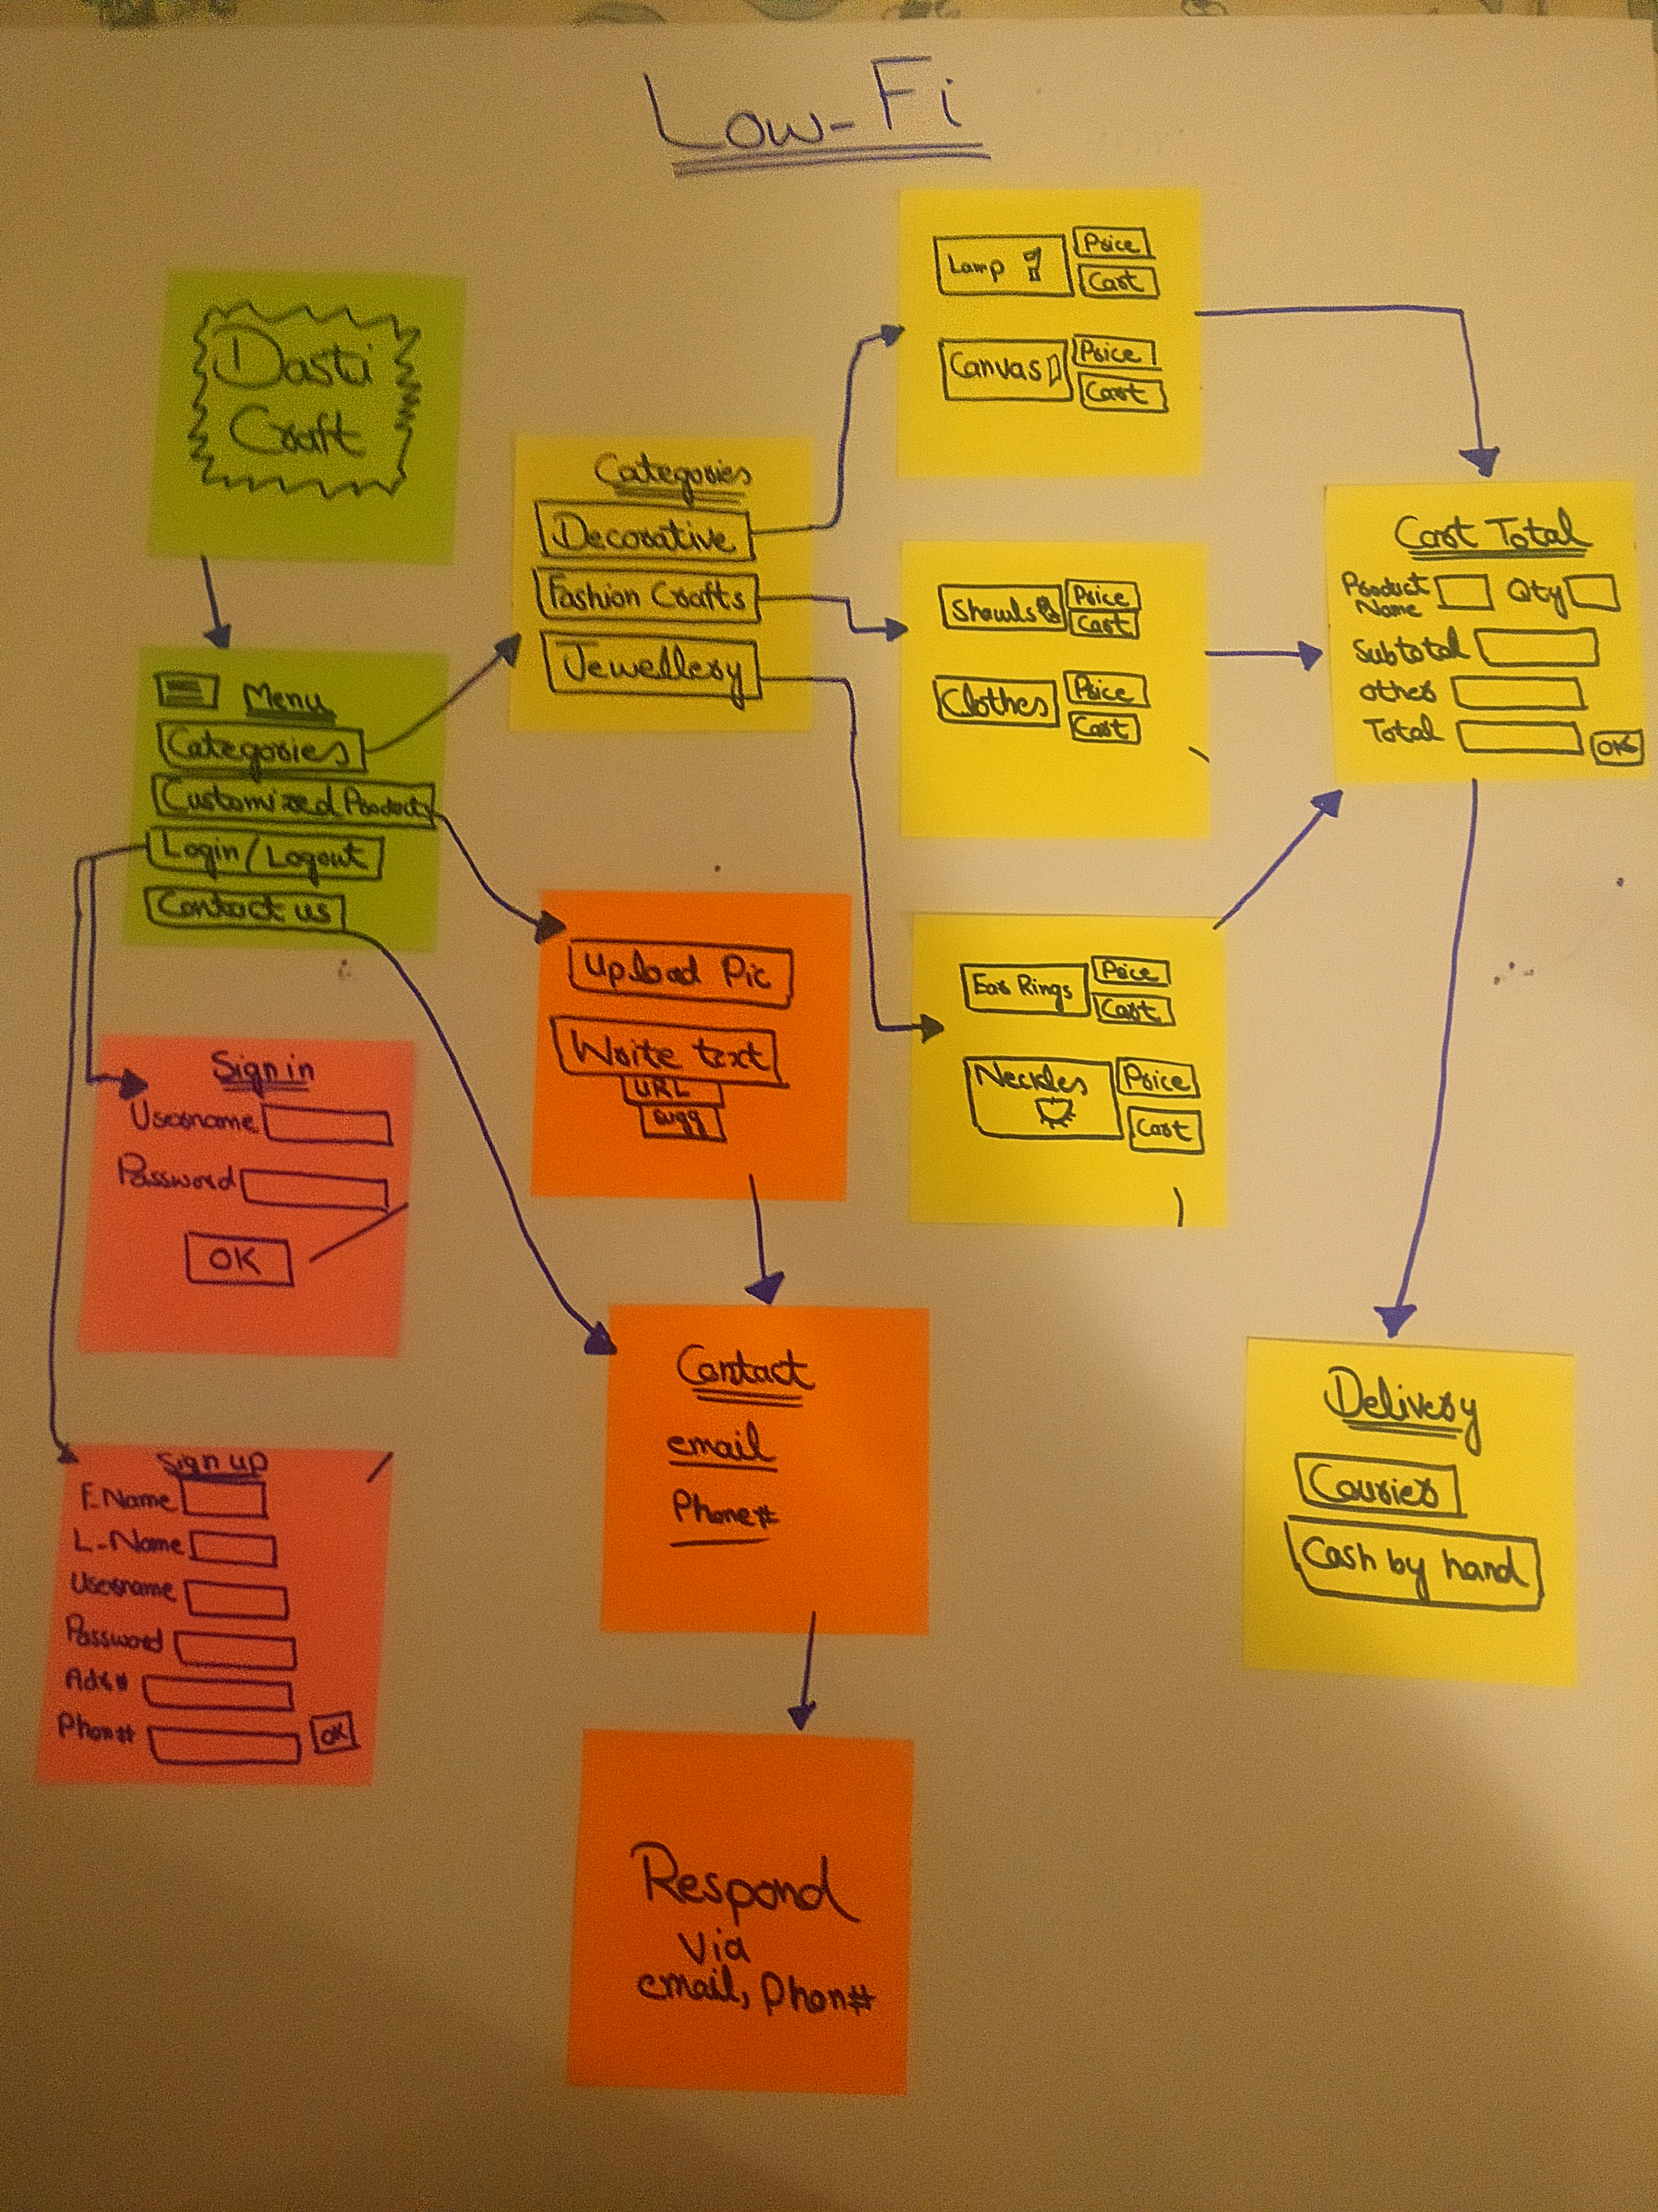
Low-fi Prototype

Slide 10
Medium-fi Prototype Demo
https://marvelapp.com/49ea22b

Slide 11
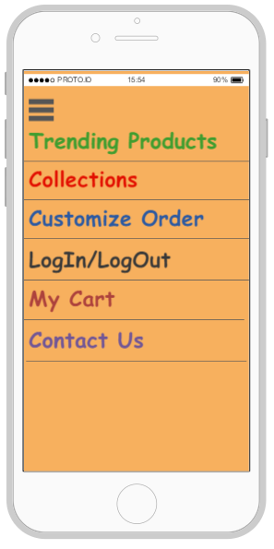
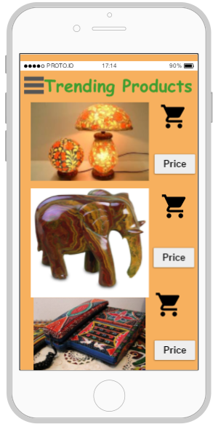
Final Prototype

Slide 12
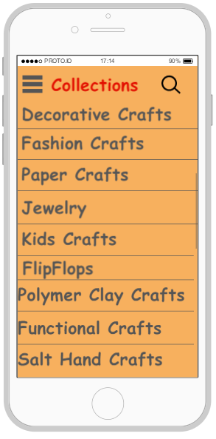
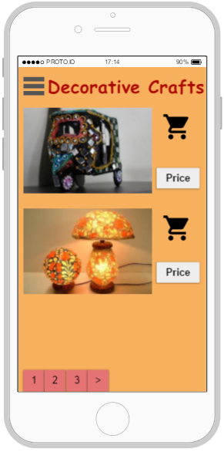
Final Prototype

Slide 13
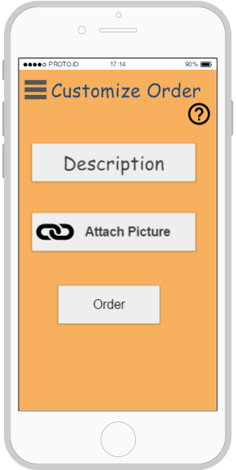
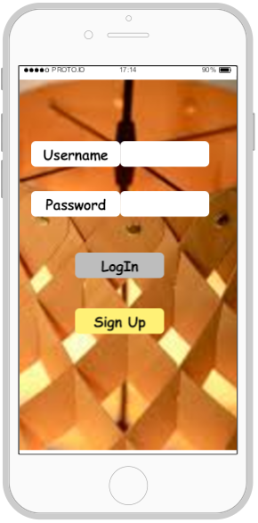
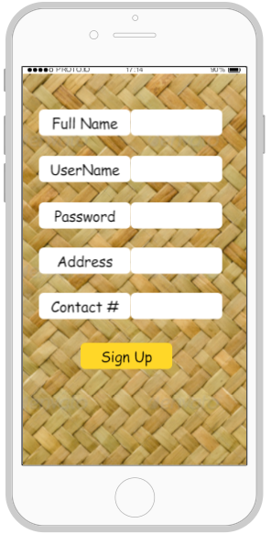
Final Prototype

Slide 14
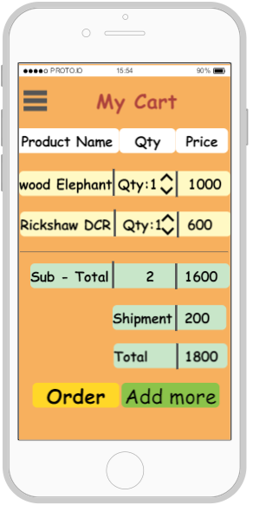
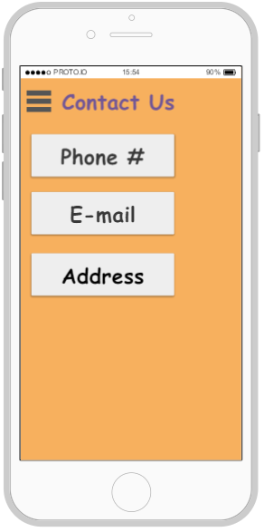
Final Prototype

Slide 15
Hi-Fi Prototype Demo
https://pr.to/QYU6YI/

Slide 16
Web Link
www.dasticrafts.wordpress.com

Slide 17
Thank You

